Slide 1

Simple Calculator
(Code Function, Pseudocode and Flowchart)

Slide 2
Code function
Perform a calculation using basic operators.
Choose a valid operator from ( /, +, -, and *).
If the operator is invalid, prompt to try again and loop back on choosing an operator.
Once a valid operator is used, prompt to input a number. If number is invalid, prompt to enter a valid number.
Once a valid number is used, process the operation and display the output.
Prompt the user if they want to restart the program or not.

Slide 3
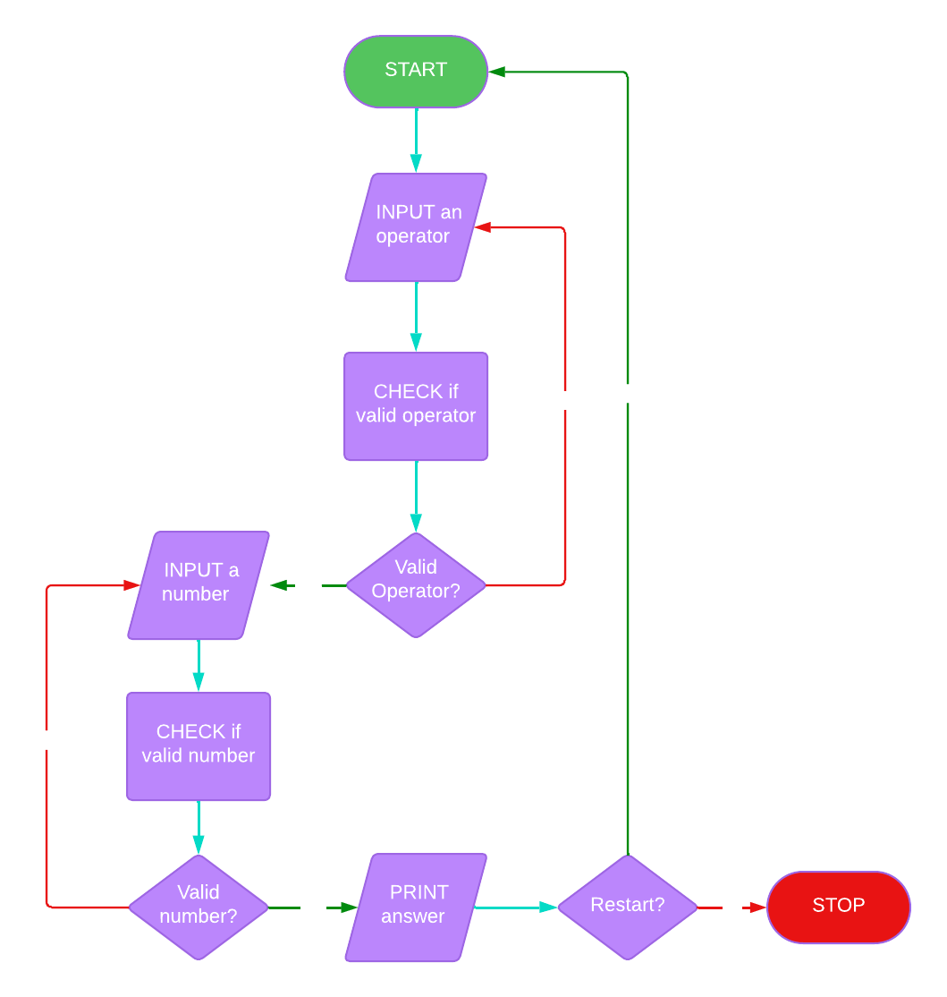
Pseudocode
Flowchart
START
INPUT an operator
CHECK the condition. If the operator is valid, go to step 4, Else, PRINT(f"{operator} isn't a valid operator! Please try again.“) and go back to step 2.
INPUT a number
CHECK the condition. If the number is valid, go to step 6, Else, PRINT("Invalid input! Please enter a valid number.“) and go back to step 4.
PRINT the answer to the operation
CHECK if user wants to restart or not the program. If yes, go to step 1. Else, STOP the program.

